Slide 1

KNOWLEDGE DISCOVERY AND MANAGEMENT PROJECT
SUMMER -2016
RECOSMART
- Team Heats (Team 6)
1.SRICHARAN PAMURU(28)
2.PRUDHVI RAJ MUDUNURI (22)
3.SNEHAL VANTASHALA (41)
4. BHARGAV KRISHNA VELAGAPUDI (42)

Slide 2
OBJECTIVES:
The goal of our project is to come up with a recommendation system for articles in different domain areas to bring the user a specific search blog or engine.
It will help the user to understand how the scalability and necessity of the article is considered.
Our recommendation engine would return the articles to be recommended in a list along with the associated hyperlink.
This would help the user view topics of similar interest. Machine learning algorithms run in the background to bring a result yielding a knowledge graph where there is a proper connection between the elements, which in our case is articles, dynamically

Slide 3
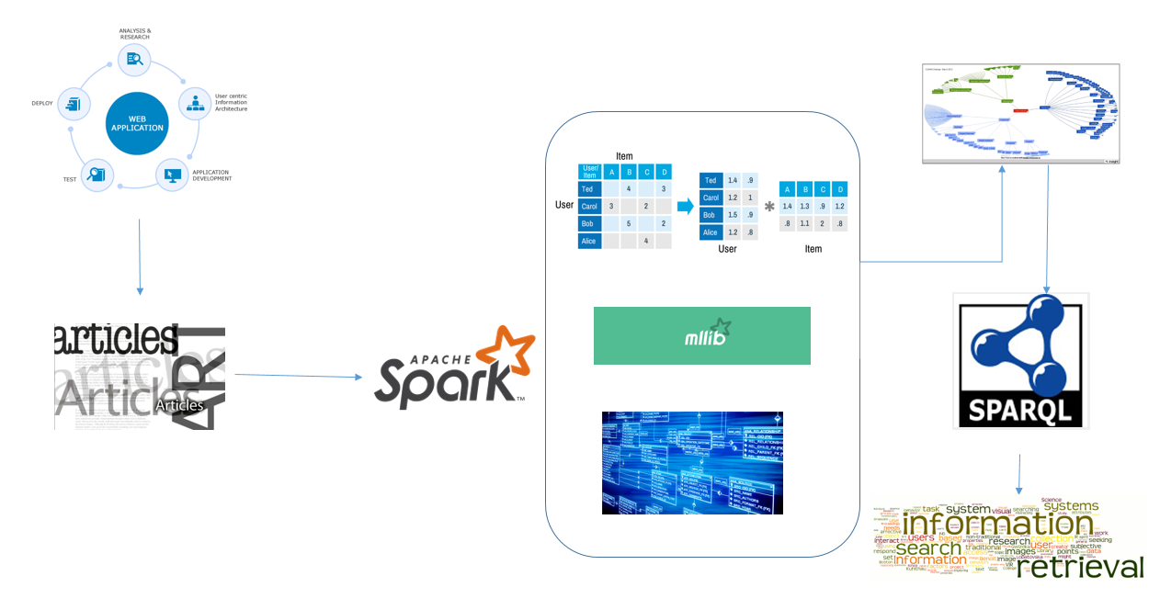
ARCHITECTURE:

Slide 4
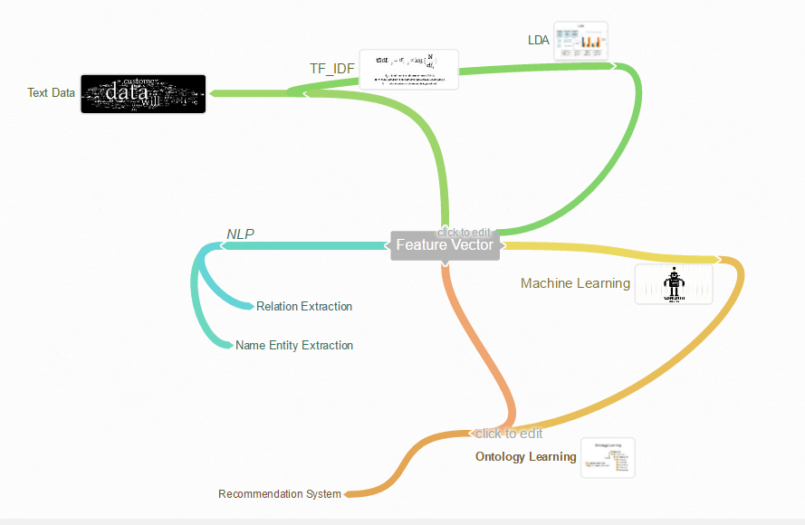
WORKFLOW:

Slide 5
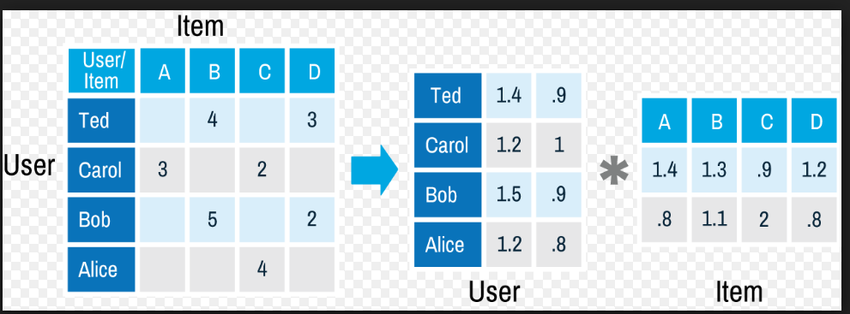
ALGORITHM USED:
Collaborative Filtering:
Naïve Bayes Classsification

Slide 6
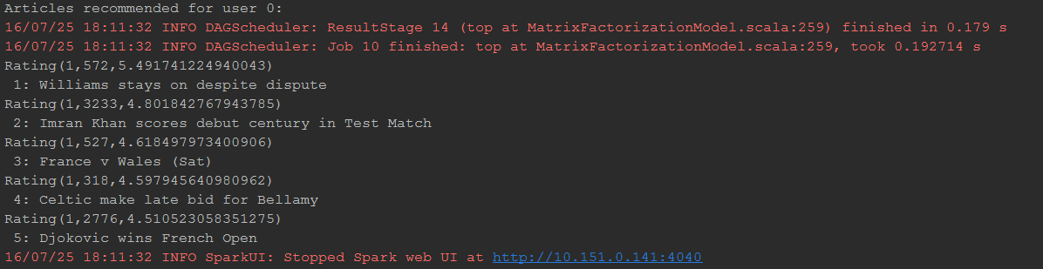
OUTPUT DEMO:

Slide 7
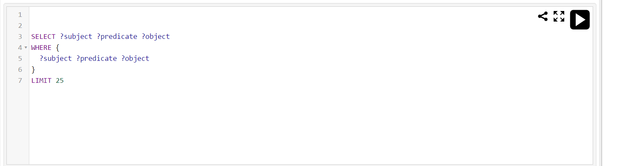
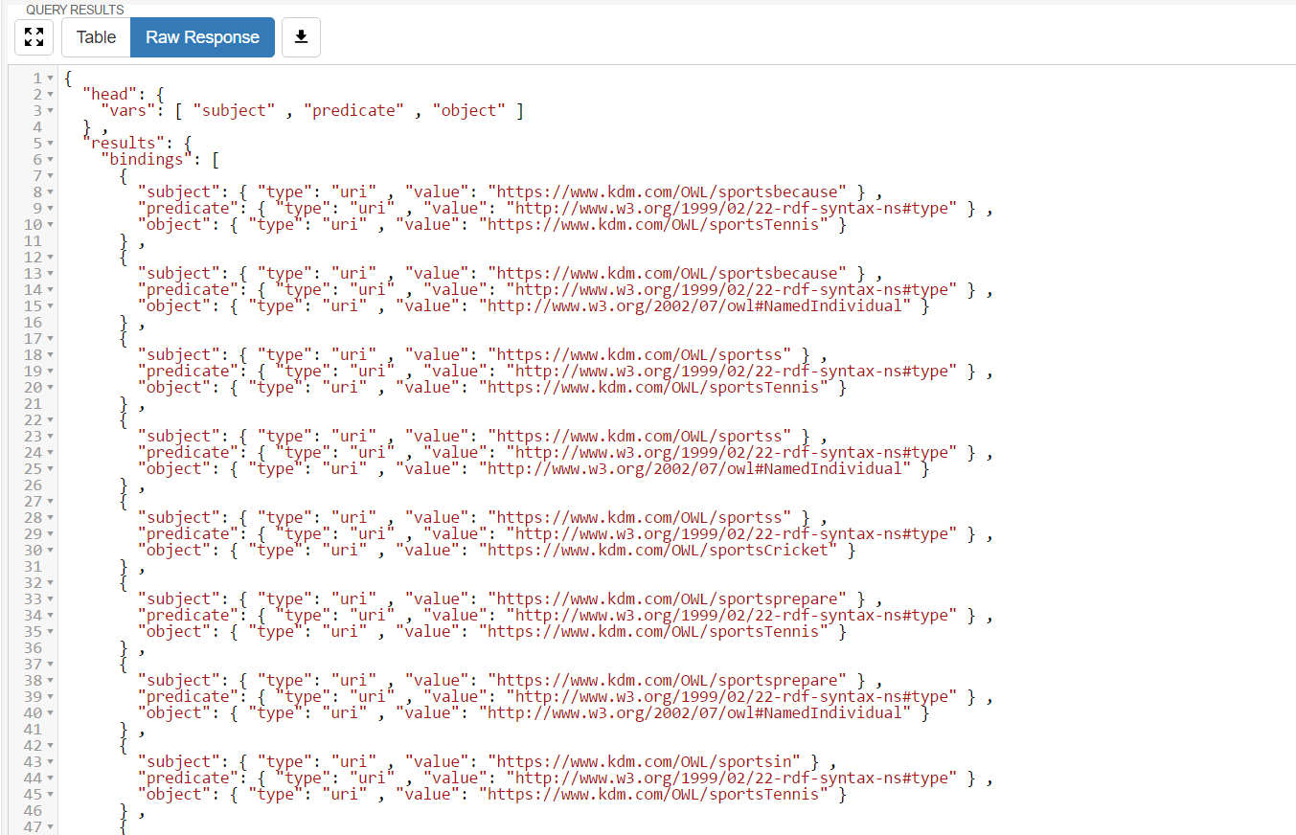
SparQL
Apache Jena Fuskei

Slide 8
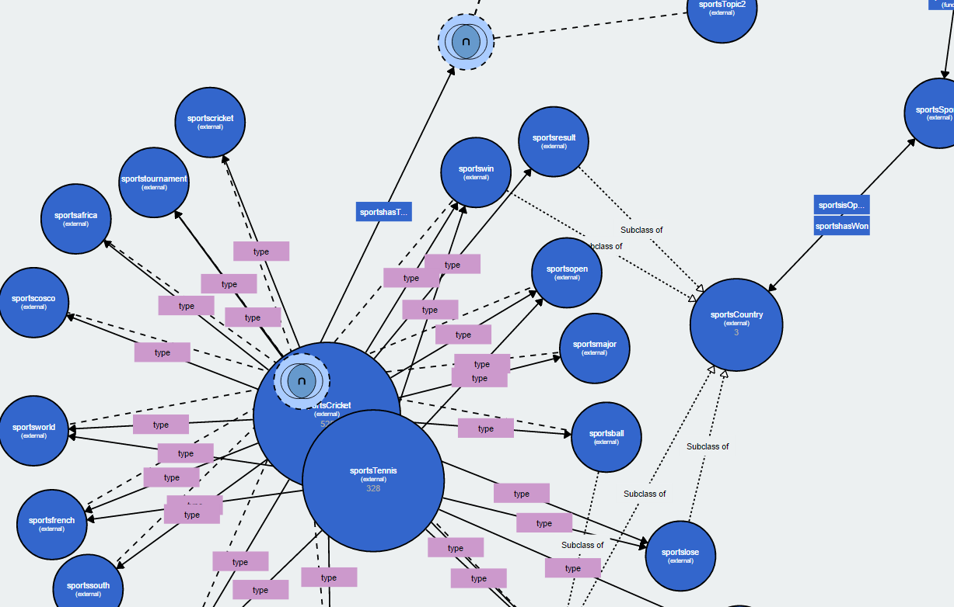
ONTOLOGY:
WebVowl

Slide 9

Video Demo:
YouTube URL: https://www.youtube.com/watch?v=EENdGUg-4V8&feature=youtu.be

Slide 10
Thank You !

